Slide 1

Just Eat Takeaway
Alexander Klein
Data engineer candidate
2021

Slide 2




Thoughts before applying
Cool stack
I really want to develop my skills and find something new. This is a good opportunity for me
A lot of data
These guys have a lot of data from different sources. That means I’ll have a lot of interesting and hard tasks
2

Slide 3

Receiving tech task
Choose any technology
Data from external systems
Dockerize the process
Task
Orchestrate the ETL process
Create presentation
Not forget about logging and handling
Answer the analytic questions
Challenge yourself
3

Slide 4

Choosing technologies
PostgreSQL It is an easy to use and free database with simple container handling.
Python It is a convenient programming language in which there are already many libraries for working with data.
Docker This tool has become the standard for working with virtual environments in recent years.
Airflow This tool is gaining popularity because it has a web interface, the required set of features and jobs in it are written in Python code
Docker-compose We need this tool for container orchestration. It comes with Docker so you can use it out of the box
3

Slide 5





Was DevOps process a challenge?
Spoiler: definitely yes…

Slide 6
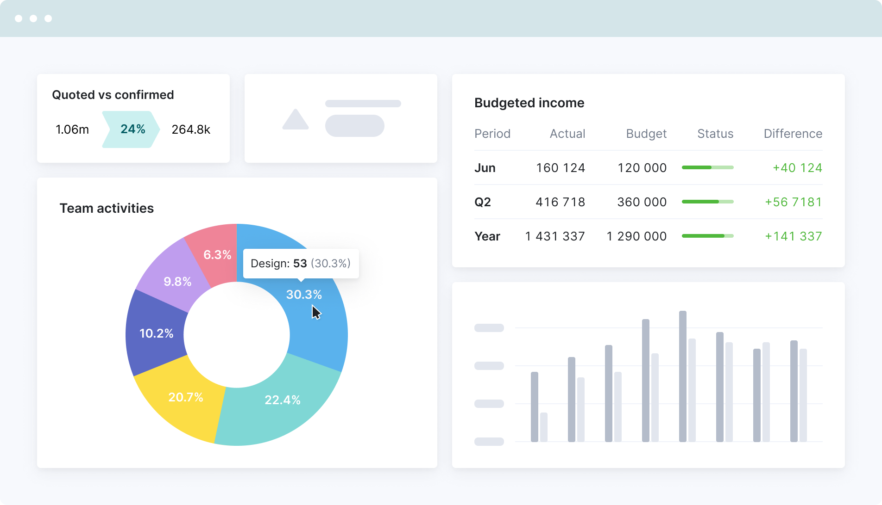
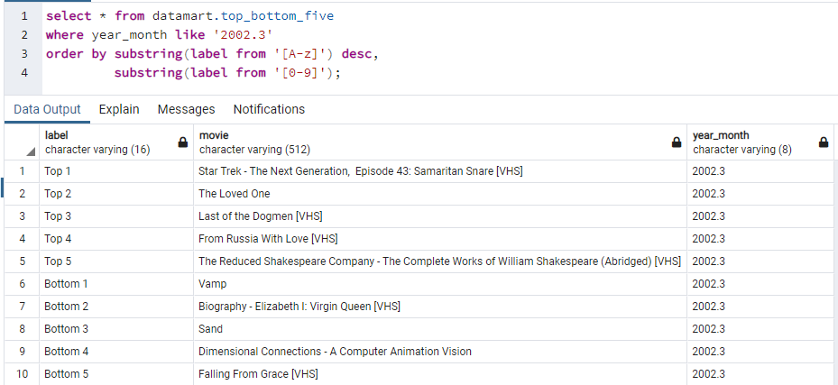
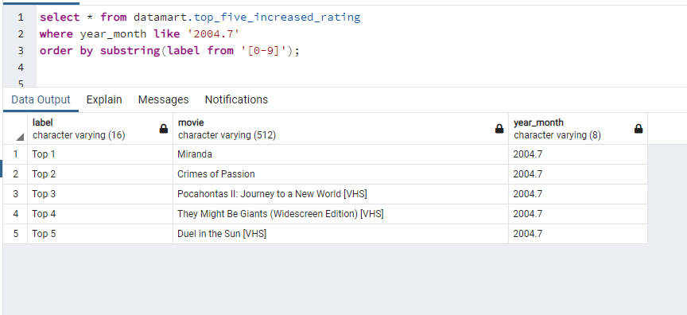

What next? Of course, dashboards!

Slide 7

We need more improvements!
Add system for working with log files
We need dashboards, so we need a visualization system
Tests! We need more tests!
Create metadata management system

Slide 8


Erg bedankt
From AlexKlein to Just Eat Takeaway
http://job.alfabank.ru/ekaterinburg/vacancies/

